Slide 1
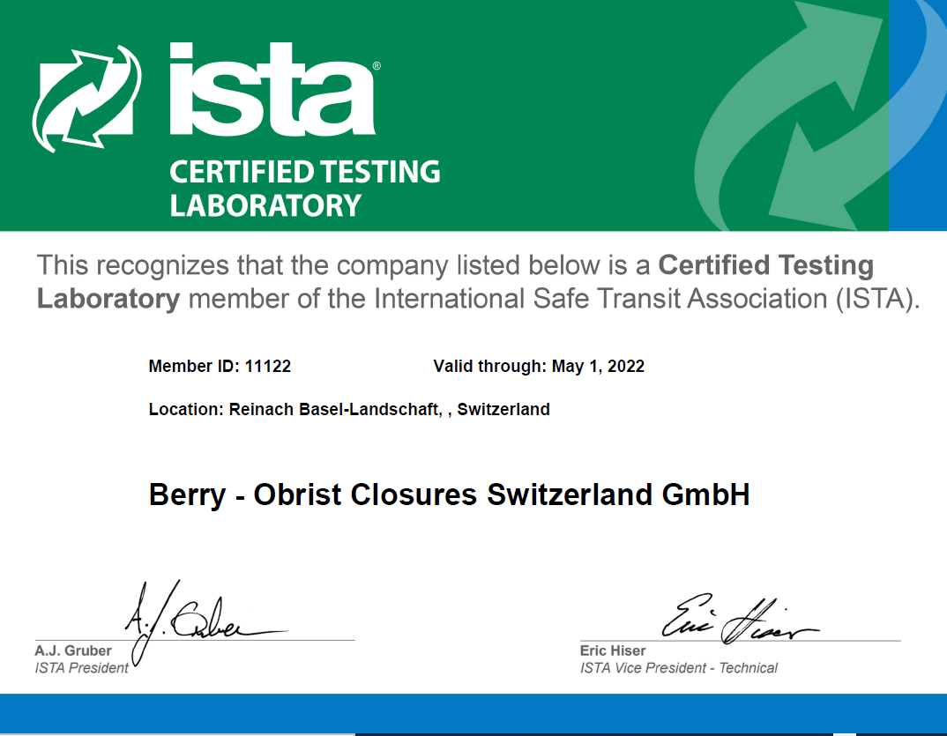
Approved testing facility at Reinach, Switzerland
Certified e-commerce testing laboratory

